Slide 1
WCBD MEDIA KIT

Slide 2
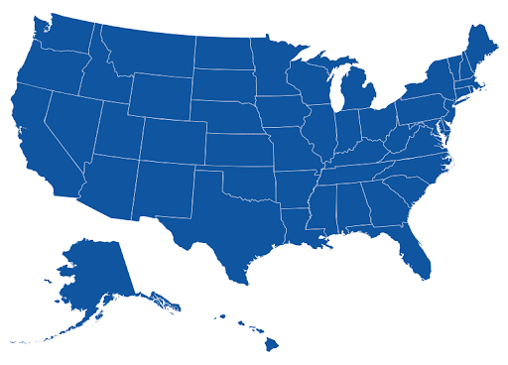
WHO ARE WE?
Nexstar Media Group, Inc. is America’s largest local television and media company with 198 full power stations (including partner stations) in 116 markets addressing nearly 62% of U.S. television households and a growing digital media operation. Nexstar’s platform delivers exceptional local content and network programming to inform and entertain viewers, while providing premium, scalable local advertising opportunities for advertisers and brands across all screens and devices.

Slide 3
NEWS 2
BROADCAST

Slide 4
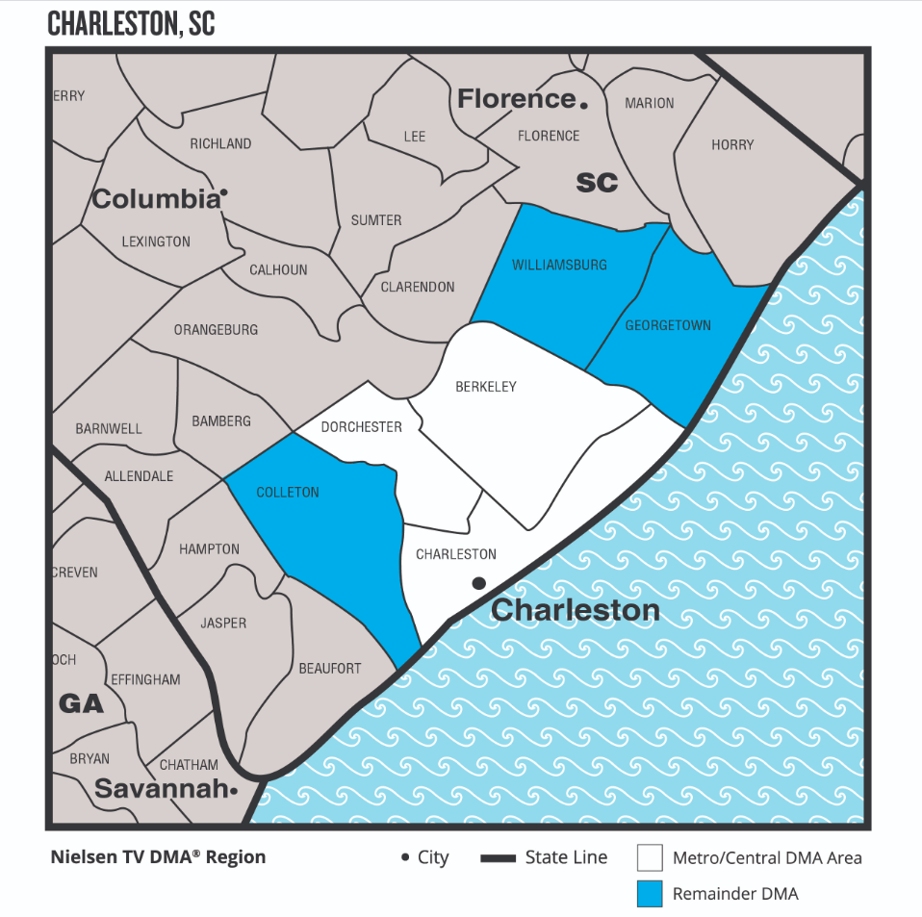
CHARLESTON DMA
U. S. CENSUS ESTIMATES, JULY 2021

Slide 5
WCBD Household Universe Estimates January 2023

Slide 6
WCBD VIEWERS AT A GLANCE
Source: Nielsen Scarborough Data 2022

Slide 7
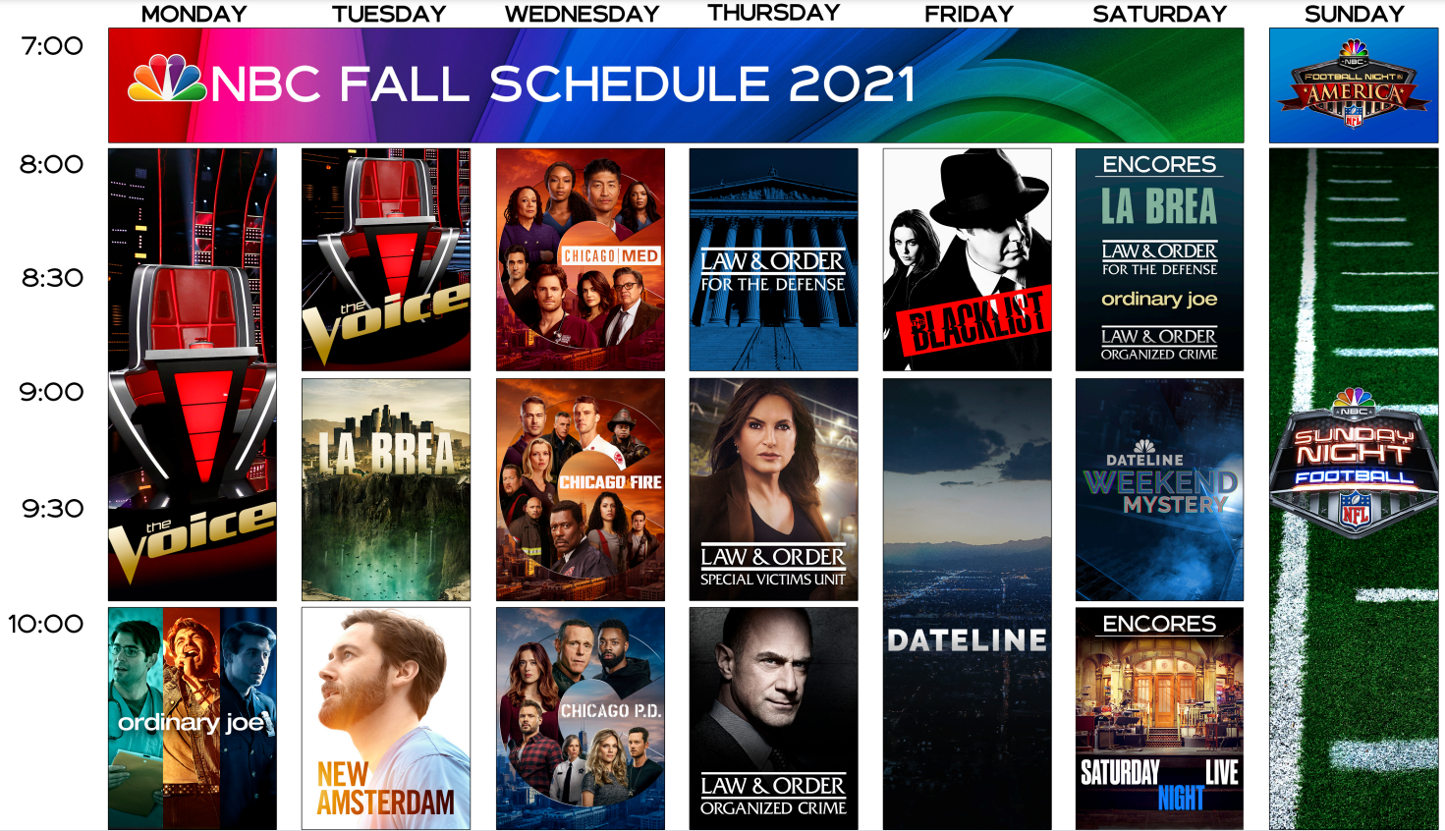
NBC PROGRAMMING

Slide 8
CW VIEWERS AT A GLANCE
Source: Nielsen Scarborough Data 2022
Source: Nielsen Scarborough Data 2020

Slide 9
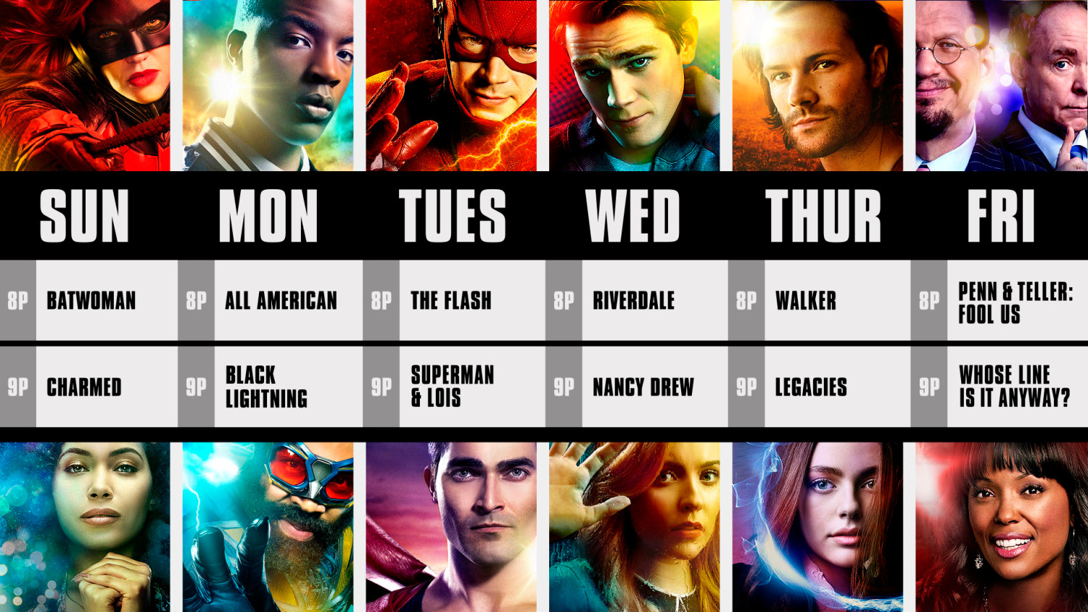
CW PROGRAMMING

Slide 10
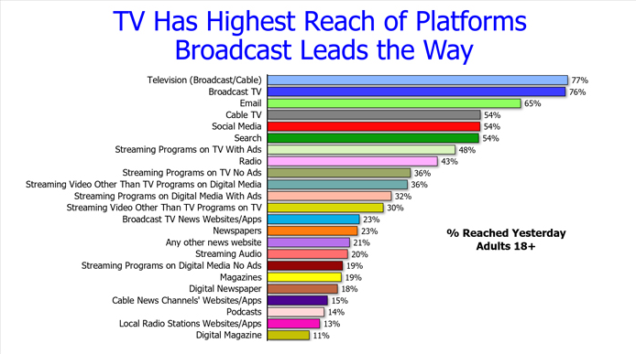
WHY ADVERTISE ON TELEVISION
% Reached yesterday Adults 18+

Slide 11
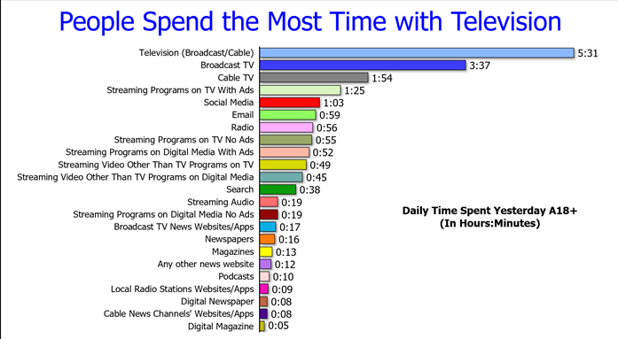
WHY ADVERTISE ON TELEVISION

Slide 12
WHY ADVERTISE ON TELEVISION
People Spend the Most Time with Television

Slide 13
News 2 Dominates the East Cooper Area!

Slide 14
Reach the Most People in Your Market with News 2!
Average Audience
Weekdays, March 2022, HHI $75K+

Slide 15
NEWS 2
DIGITAL

Slide 16
2,800,000
COUNTON2.COM AT A GLANCE
AVERAGE PAGE VIEWS PER MONTH
850,000
AGE
AVERAGE MONTHLY VISITORS
02:39
AVERAGE SESSION DURATION
Source: CountOn2.com April 2020 – March 2021

Slide 17
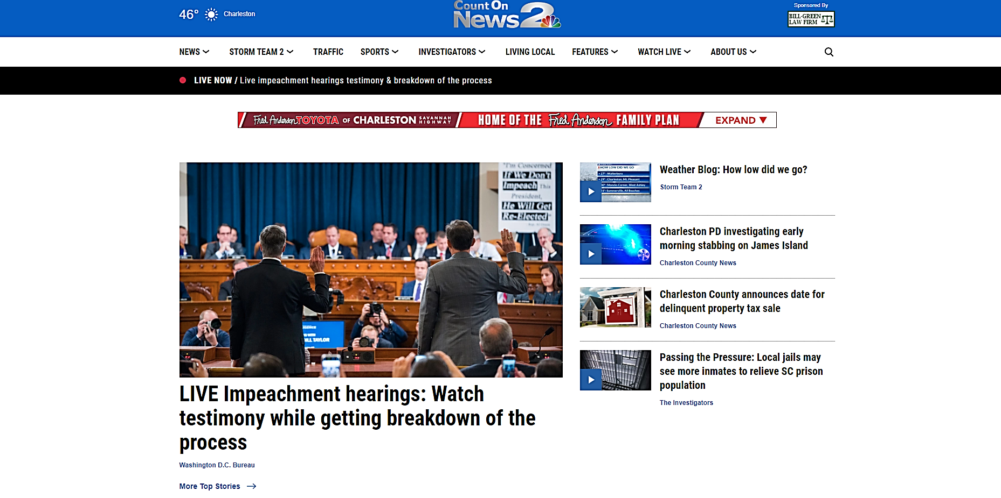
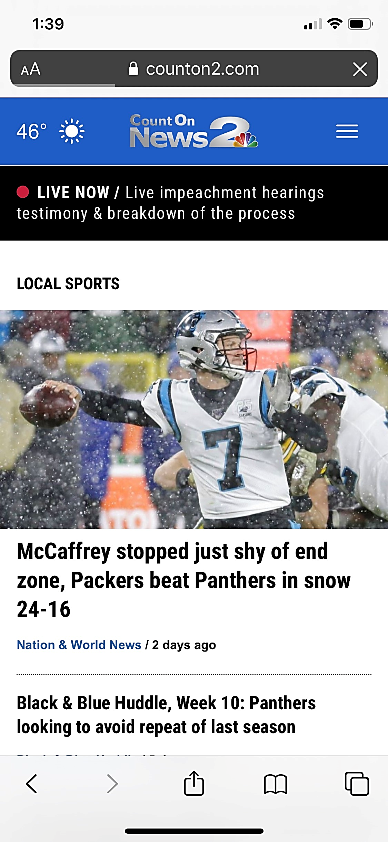
COUNTON2.COM PRODUCTS
Pre Roll Video
Outstream Video
Mobile Video Overlay
In Banner Video Ads
Sponsorships
Native
Lifestyle Video Segments
Live stream News 2
Display Ads
Rich Media
Takeovers
App Opens
Interstitials

Slide 18
THANKS!
Any questions?
You can find me at
tcokeley@wcbd.com

